Slide 1
Naloga 4 - Spletne storitve s podatkovno bazo
Entity Framework 6.2.0

Slide 2
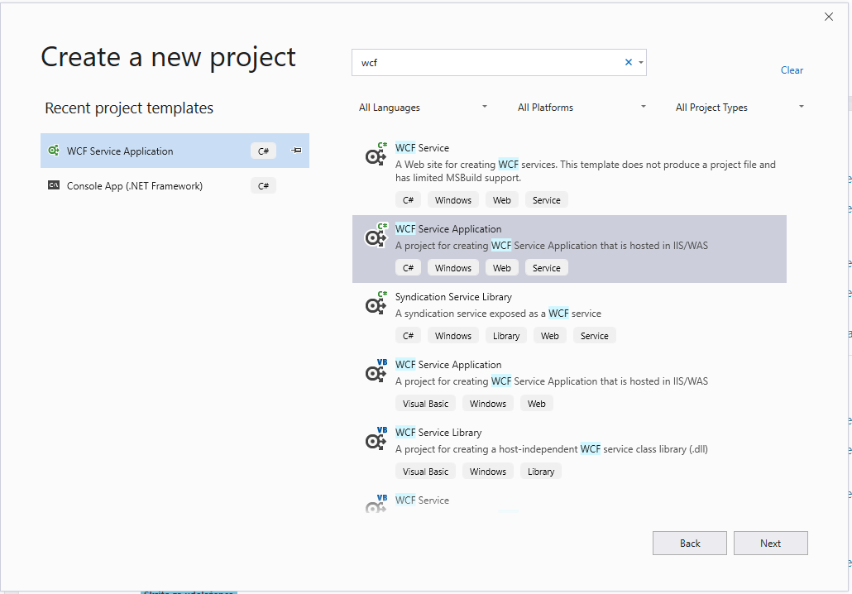
Visual Studio projekt
Nadaljujte s starim projektom
NuGet -> Entity Framework 6.4.0
Vključimo using System.Data.Entity;

Slide 3
Migracije baze
Zaporedje korakov kako smo prišli do obstoječe (trenutne) verzije podatkovne baze
Vsaka migracija vsebuje metodi:
Up() -> Ukazi, da bazi dodamo / odstranimo / spremenimo atribute
Down() -> Ukazi, da bazo povrnemo v stanje pred migracijo

Slide 4

Migracije baze
Ukazi v Package Manager Console (vir:NuGet)
Ukaz: Enable-Migrations
Ob vsaki spremembi Razredov kličemo:
Add-Migration <ImeMigracije>
Update-Database
Implicit conversion (https://stackoverflow.com/questions/22133232/code-first-migration-error-implicit-conversion-from-data-type-nvarcharmax-to)
https://docs.microsoft.com/en-us/ef/ef6/modeling/code-first/migrations/

Slide 5
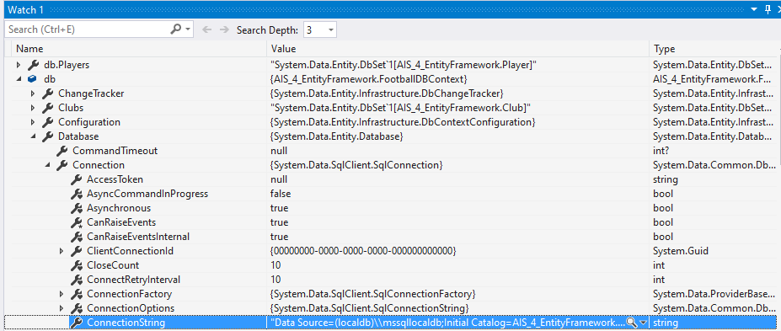
Podatkovna baza
Kako najti kje se nahaja? (1)
Server Explorer -> Add

Slide 6
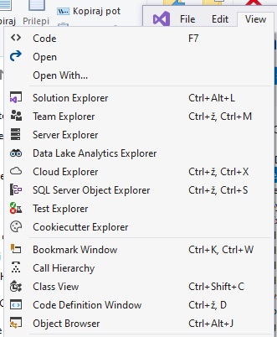
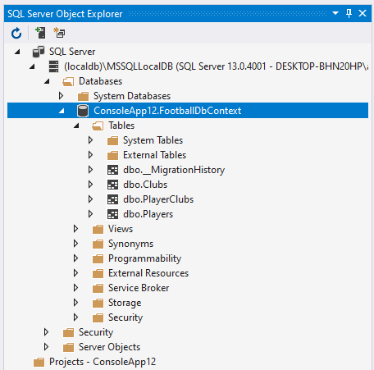
Podatkovna baza
Kako najti kje se nahaja?
View -> SQL Server Object Explorer -> SQL Server -> (localdb) -> Databases

Slide 7
Pred generiranjem 1. iteracije baze
Pri obstoječih razredih pazite, da:
Imate javne getterje in setterje
Vsak razred je javen public class Club {...}
Vsak razred ima atribut public int Id { get; set; }

Slide 8
public class FootballDbContext : DbContext
{
public FootballDbContext() { }
public DbSet<PlayerClub> PlayersClubs { get; set; }
public DbSet<Player> Players { get; set; }
public DbSet<Club> Clubs { get; set; }
}
...
FootballDbContext db = new FootballDbContext();...

Slide 9
Primer One:Many
public class Player
{
public int Id { get; set; }
public string Name { get; set; }
public string Surname { get; set; }
public int YearOfBirth { get; set; }
public virtual ICollection<Club> Clubs { get; set; }
}
public class Club
{
public Club()
{
this.Players = new HashSet<Player>();
}
public int Id { get; set; }
public string Name { get; set; }
public string Stadium { get; set; }
public int YearOfEstablishment { get; set; }
public virtual ICollection<Player> Players { get; set; }
}

Slide 10
Primer Many:Many
PC
C
P
PC
PC
Z vmestno entiteto Klub – IgralecKlub - Igralec
public class Player
{
public int Id { get; set; }
public string Ime { get; set; }
public string Priimek { get; set; }
public int LetoRojstva { get; set; }
public ICollection<PlayerClub> PlayerClubs { get; set; }
}
public class PlayerClub
{
public int Id { get; set; }
public int IgraOd { get; set; }
public int IgraDo { get; set; }
public Player Player { get; set; }
public Club Club { get; set; }
}
public class Club
{
public int Id { get; set; }
public string Ime { get; set; }
public int LetoUstanovitve { get; set; }
public ICollection<PlayerClub> PlayerClubs { get; set; }
}

Slide 11
Primer X:Many (če ne dela)
Na strani entitete, kjer je mnogo primerkov dodamo konstruktor
public class Club
{
public int Id { get; set; }
public string Ime { get; set; }
public int LetoUstanovitve { get; set; }
public ICollection<PlayerClub> PlayerClubs { get; set; }
}
public class Club
{
public Club()
{
PlayerClubs = new HashSet<PlayerClub>();
}
public int Id { get; set; }
public string Ime { get; set; }
public int LetoUstanovitve { get; set; }
public ICollection<PlayerClub> PlayerClubs { get; set; }
}

Slide 12
Dodajanje
...
Player player = new Player("Jozek", "Brancko", 1998);
db.Players.Add(player);
db.SaveChanges();
...

Slide 13
Iskanje (1 / n elementov)
... // 1 element
Club dodajIgralcu = db.Clubs.Where(club => club.Name == "NK Domacica").FirstOrDefault();
...
// Poljubno mnogo elementov
List<Player> seznamIgralcev = db.Players.Where(p => p.YearOfBirth == 2000).ToList();
...

Slide 14
Brisanje (1 / n elementov)
...
var iskanJanez = db.Players.Where(x => x.Ime == "Janez").FirstOrDefault(); //Iskanje max 1 Janeza
db.Players.Remove(iskanJanez); //Izbris 1 elementa
db.SaveChanges(); //Shrani spremembe
...
var iskaniJanezi = db.Players.Where(x => x.Ime == "Janez").ToList(); //Iskanje vseh Janezov
db.Players.RemoveRange(iskaniJanezi); //Izbris seznama / polja elementov
db.SaveChanges(); //Shrani spremembe
...

Slide 15
Dodatni viri
https://docs.microsoft.com/en-us/ef/ef6/modeling/code-first/migrations/
https://stackoverflow.com/questions/15220411/entity-framework-delete-all-rows-in-table
https://entityframework.net/many-to-many-relationship
https://www.entityframeworktutorial.net/code-first/what-is-code-first.aspx

